Slide 1
Building Cross-Platform Enterprise Mobile Apps with Visual Studio and Xamarin
Pierce Boggan
@pierceboggan
Program Manager, Microsoft

Slide 2
Agenda
9AM-9:45AM: Introduction to Xamarin
10AM-10:45AM: Introduction to Xamarin.Forms
11AM-11:45AM: Your First Mobile App
12PM-1PM: Lunch
1PM-1:45PM: Your First Mobile App, Part 2
2PM-2:45PM: Azure Mobile Apps
3PM-3:45PM: Azure Storage & Serverless Computing
4:00PM-4:45PM: DevOps with VSTS

Slide 3
Who is this guy?
Pierce Boggan
Program Manager, Microsoft
Twitter/GitHub: @pierceboggan
Notes:
My name is Pierce Boggan and I work as a Software Engineer at Xamarin
Spend most of my time working with the latest-and-greatest in mobile C# development
Most of my day is spent building mobile apps
Moments – Snapchat clone
Azure
Xamarin.Forms
MyDriving – app we did for Microsoft Build that track driving habits and calculates a score using data from your car’s OBD reader
IoT
Traditional Xamarin
SmartCoffee
IoT + MCS
Xamarin.Forms Apps
Extended to make a “smart office” concept (Philips Hue for lights, motor for closing door)
Smarter apps transition
Users expect our apps to be able to do more and more… and to make it easier and easier to interact with the interface.
Our phones have lots of sensors and such (camera, microphone, acceleromter, etc.) – we should better utilize these when we are thinking about building mobile apps. Often, we only consider touch interaction.
Machine Learning / AI
Lots of potential for adding Machine Learning / AI into our apps, but always found it a challenging topic
Took a class during university on the topic, and didn’t come away with any actionable knowledge besides a few very simple non-practical algorithms
Have to be a PhD student or statistician to get it moving, and I’m definitely not that guy

Slide 4





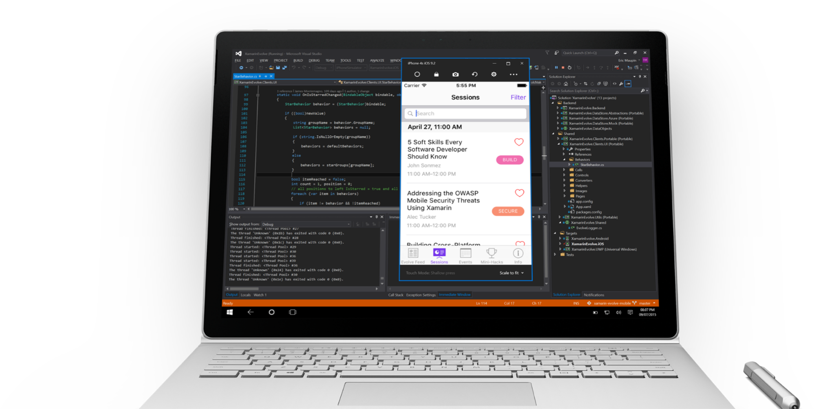
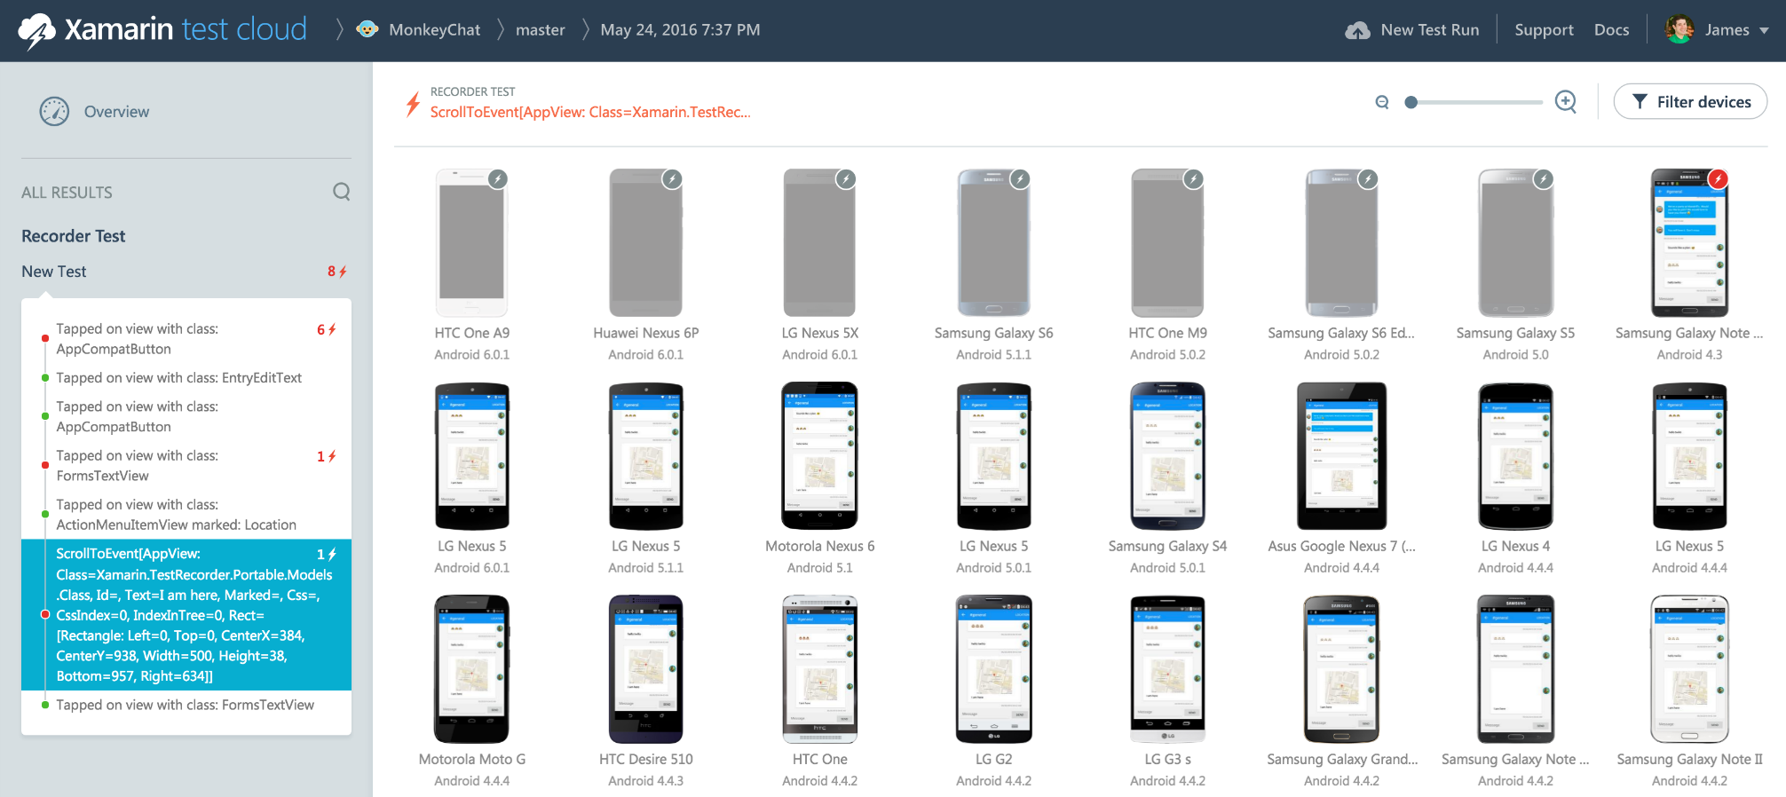
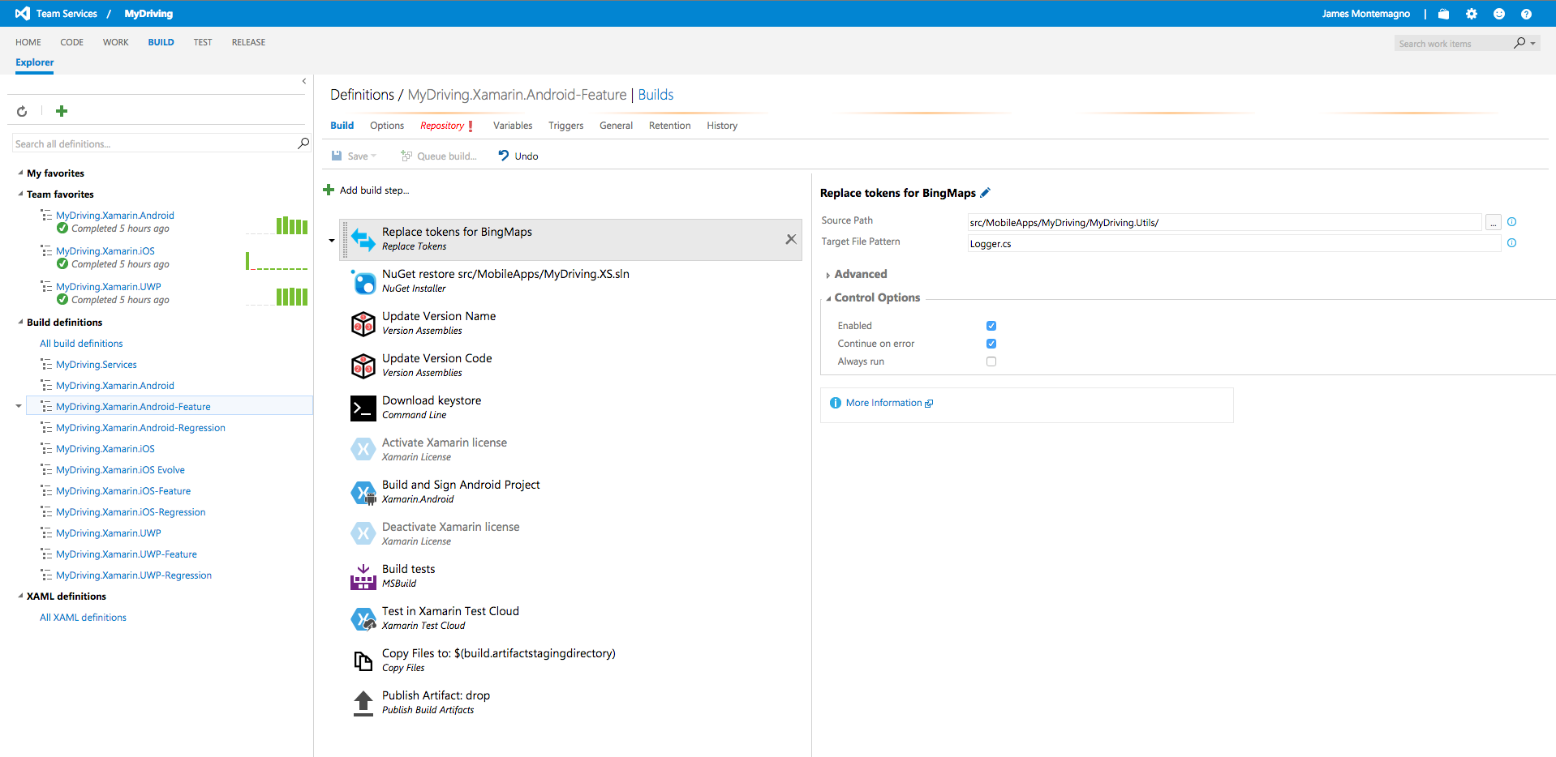
Xamarin – Your Complete Mobile Solution
Develop
Test
Build
Distribute
Monitor
Notes:
Xamarin is your complete mobile solution.
When most people hear the term Xamarin, they think the ability to build native iOS, Android, Mac, and Windows apps in C#.
Xamarin offers a wide range of products for developers to go mobile, including Test Cloud, Hockey App.
Even educational products, such as Xamarin University.

Slide 5
Architecting Mobile Apps

Slide 6
Silo Approach
iOS
Android
Windows
Objective-C
Xcode
Java
Android Studio
C#
Visual Studio
No shared code • Many languages & development environments • Multiple teams
Notes:
What is the silo approach?
Building apps in silo with no code sharing, different languages, different environments.
Pro
Great native apps delivered to the user’s platform.
Con
Multiple teams with different skill sets
Multiple code bases
Difficult to maintain feature parity
Expensive and slow

Slide 7
Write Once, Run Anywhere
Lua
Javascript
Actionscript
HTML+CSS
App Generator
Limited native API access • Slow performance • Poor user experience
Notes:
What is write once, run anywhere?
Write your app in a language and have it go into an app generator and spit out apps.
Pro
Addressed code sharing issues.
Con
Unhappy users
Not native apps
Unhappy developers
Hampered by limitation.
Increase in app abandonment.

Slide 8
Xamarin’s Unique Approach
iOS C# UI
Android C# UI
Windows C# UI
Shared C# Mobile
Shared C# codebase • 100% native API access • High performance
Notes:
Build native apps for iOS, Android, and Windows – all in C# - with the native APIs – AND share lots of code.
Anything that’s not platform-specific can be shared.
That’s lots of the glue in your app.
Architecturally in the best case, this is just your user interface logic

Slide 9
Windows APIs
Microsoft.Phone
Microsoft.Networking
Windows.Storage
Windows.Foundation
Microsoft.Devices
System.Net
System
System.IO
System.Linq
System.Xml
System.Data
System.Windows
System.Numerics
System.Core
System.ServiceModel
Notes:
If you’re a Windows developer, you know you can use .NET APIs alongside the Microsoft APIs you know and love.
Use .NET features alongside and with Windows APIs.

Slide 10
iOS – 100% API Coverage
MapKit
UIKit
iBeacon
CoreGraphics
CoreMotion
System.Net
System
System.IO
System.Linq
System.Xml
System.Data
System.Windows
System.Numerics
System.Core
System.ServiceModel
Notes:
The same is true for iOS! We’ve taken the APIs and C#-ified them (properties, events, etc.) to make them much cleaner.
Use .NET APIs, libraries, and such alongside and with them.

Slide 11
Android – 100% API Coverage
Text-to-speech
ActionBar
Printing Framework
Renderscript
NFC
System.Net
System
System.IO
System.Linq
System.Xml
System.Data
System.Windows
System.Numerics
System.Core
System.ServiceModel
Notes:
Same is true for Android.

Slide 12
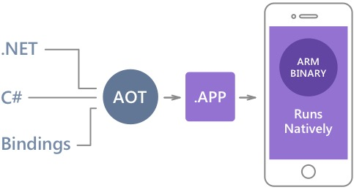
Native Performance
Xamarin.iOS does full Ahead Of Time (AOT) compilation to produce an ARM binary for Apple’s App Store.
Xamarin.Android takes advantage of Just In Time (JIT) compilation on the Android device.
Notes:
What about performance?
Xamarin.iOS produces ARM binaries for the App Store.
Xamarin.Android produces a binary that the Mono runtime + JIT. Often faster than Dalvik runtime.
Read up on early Google engineers appraisal of Xamarin in comparison to other frameworks and Obj-C/Java.

Slide 13
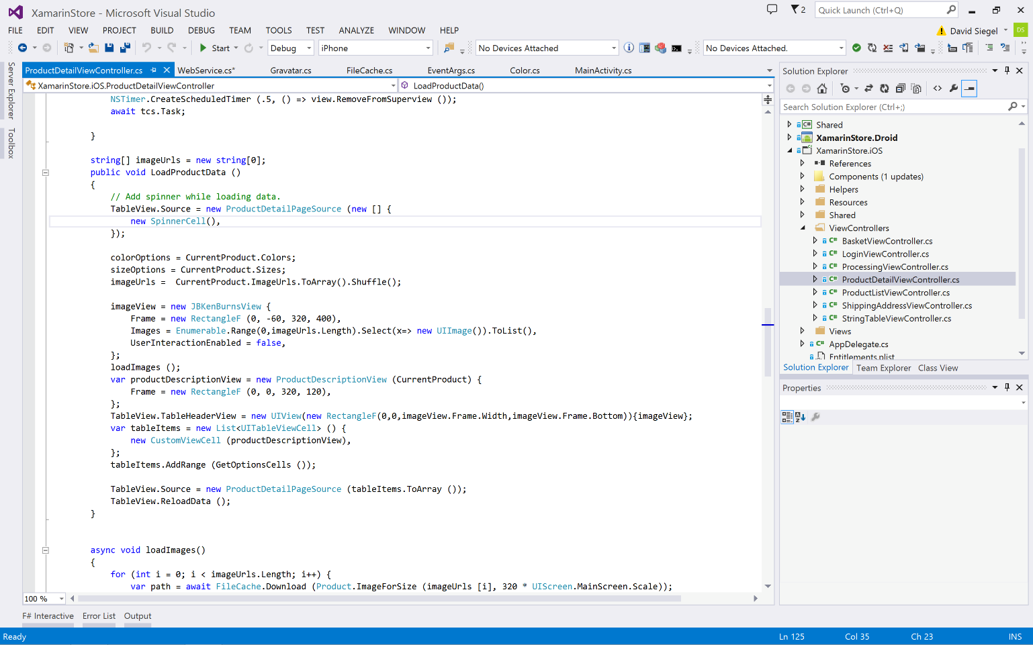
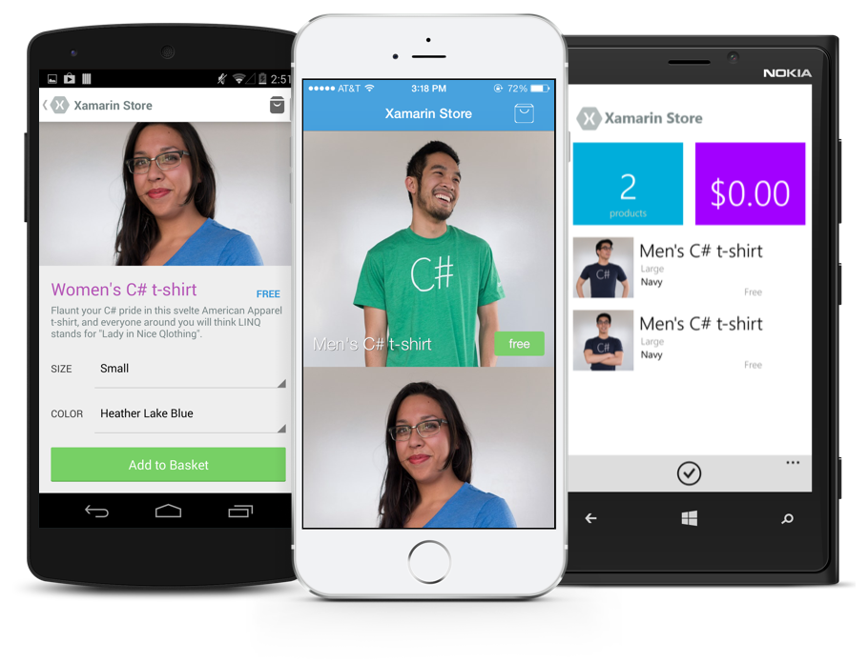
Anything you can do in Objective-C, Swift, or Java can be done in C# and Visual Studio with Xamarin.
Notes:
Say word-for-word.

Slide 14
✓Always Up-to-Date
Same-day support:
iOS 5
iOS 6
iOS 7
iOS 7.1
iOS 8
iOS 9
Full support for:
Apple Watch
Apple TV
Android Wear
Amazon Fire TV
and much more

Slide 15
Development Environment

Slide 16
Xamarin is included in Visual Studio!
Xamarin is included
in Visual Studio
Including Community Edition!
Notes:
Xamarin is now included in Visual Studio! If you have an MSDN or Visual Studio subscription, you already have Xamarin!
If you don’t, Community Edition is free for many uses.

Slide 17
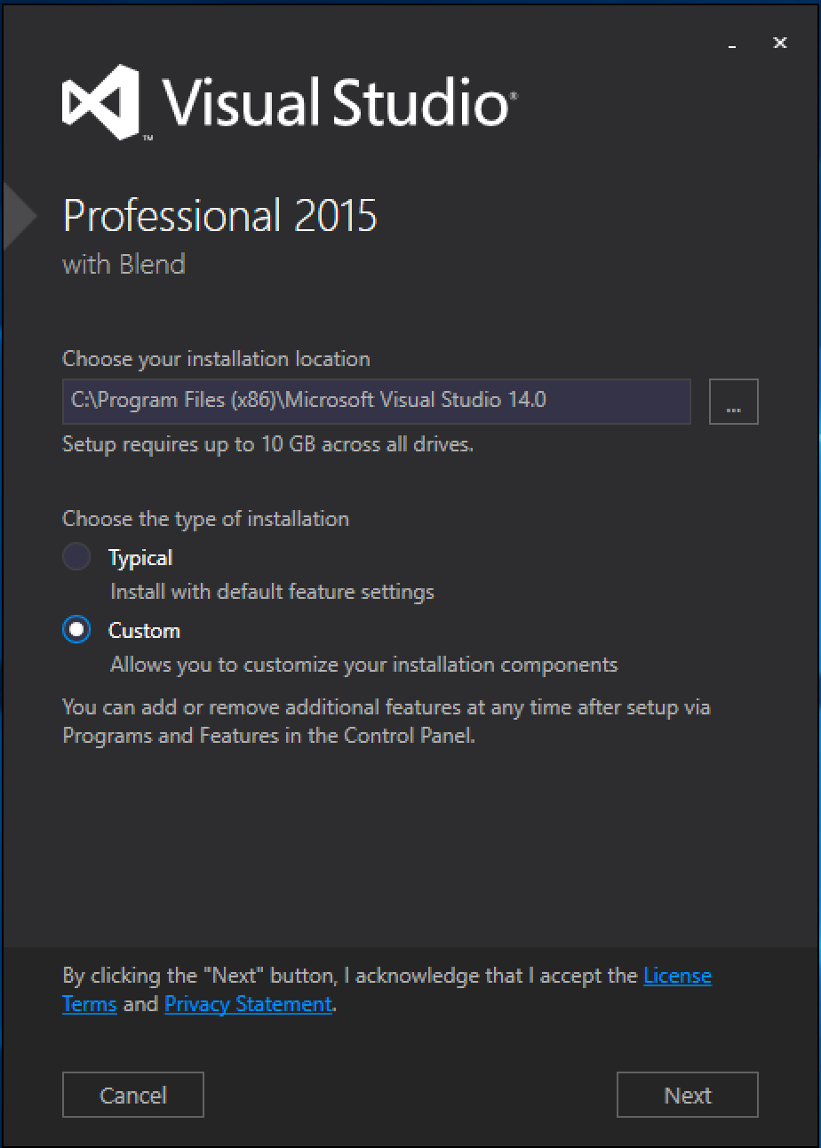
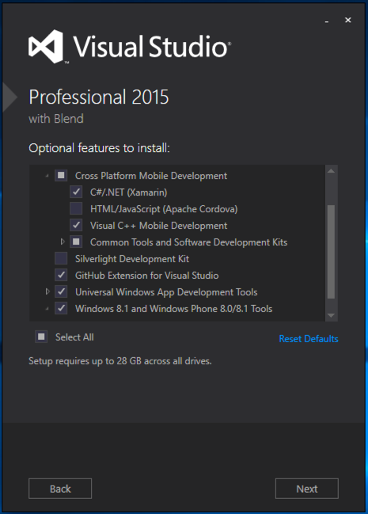
Visual Studio Integration
xamarin.com/download
Notes:
Built right into the Visual Studio installer.
If you already have Visual Studio installed, go to xamarin.com/download

Slide 18
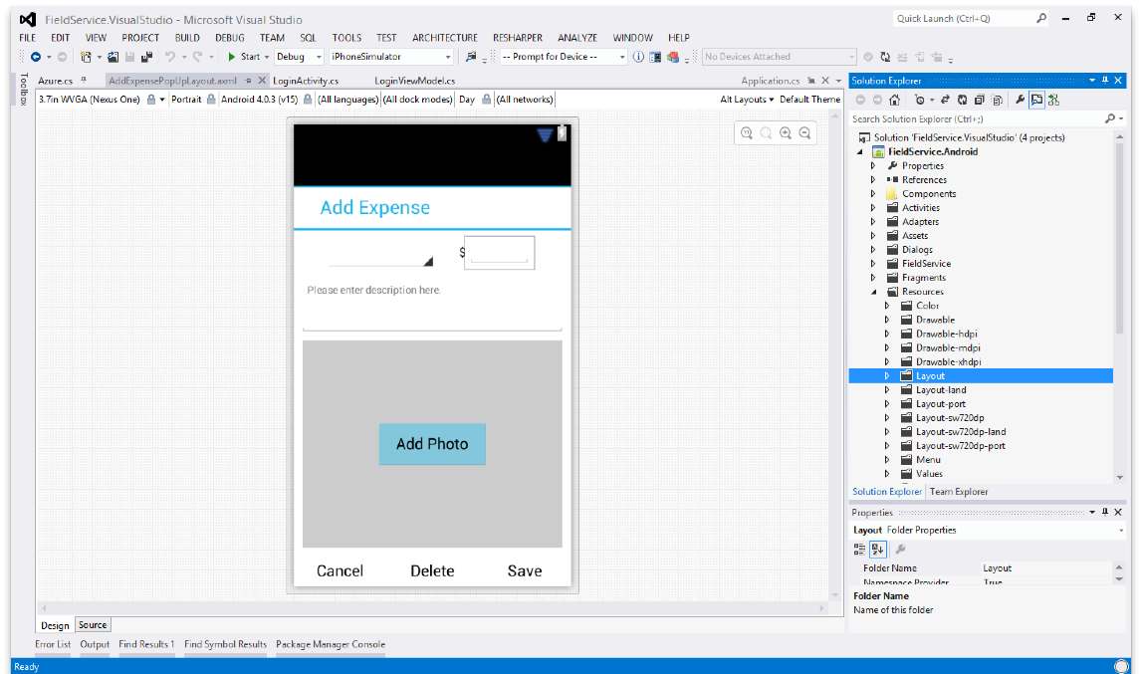
Android Designer
Create UI with drag & drop simplicity
Target multiple screen sizes, resolutions and Android versions
Layouts saved in standard Android XML files
Notes:
Designers are amazing. Help us create beautiful apps
Drag-and-drop, adjust screen size, resolution, Android versions.

Slide 19
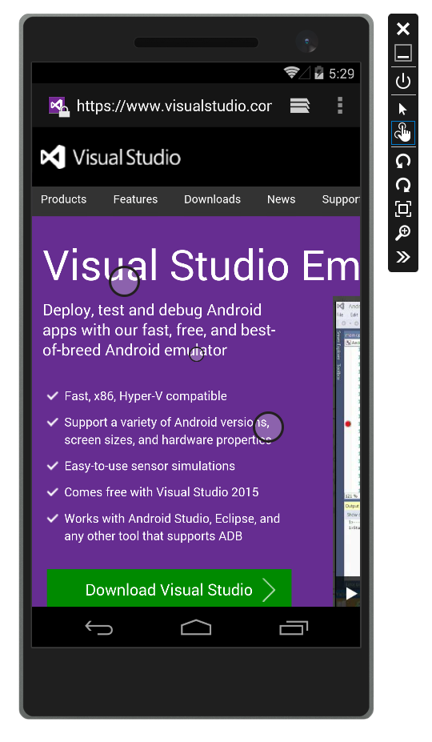
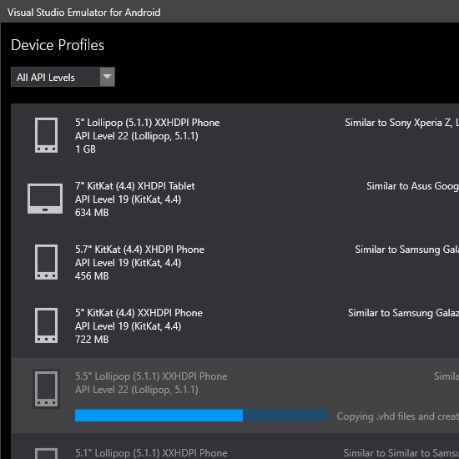
Android Hyper-V Emulators for PC
Multi-Touch Enabled
Super Fast
Rotate, screenshots, location changes, and more!
http://bit.ly/hyperv-android
Notes:
If you’ve used the Android emulators, you know they’re not a great experience.
Visual Studio Android Hyper-V emulators are amazing!

Slide 20
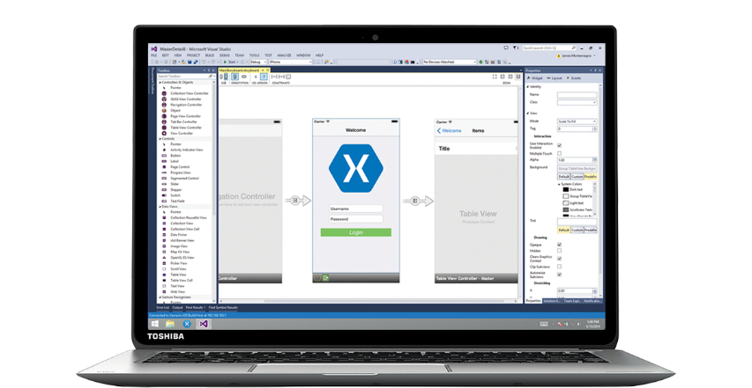
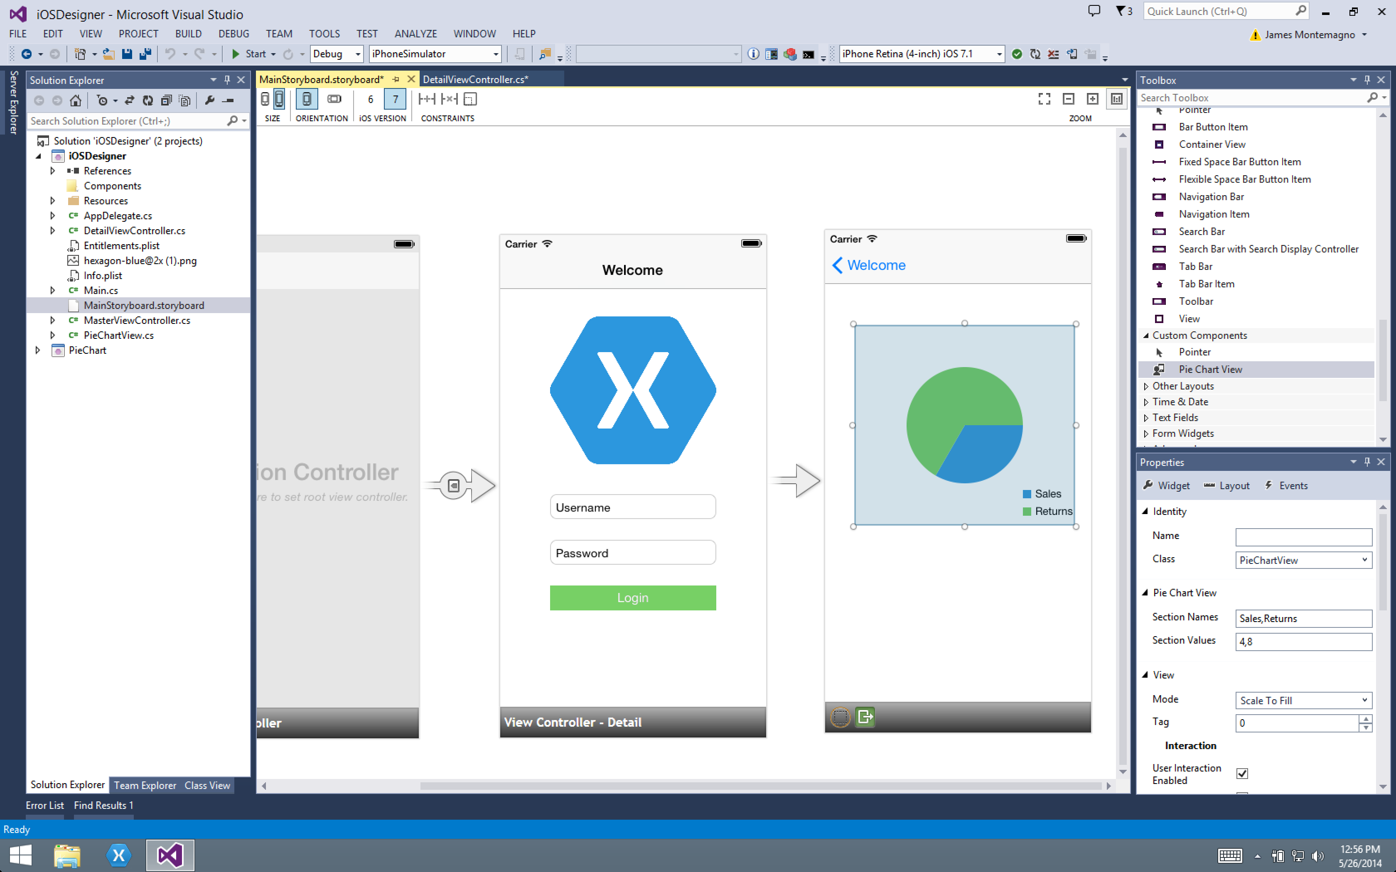
Xamarin Designer for iOS
Follows familiar Visual Studio designer idioms
Supports all UIKit elements
Edit custom and 3rd party components
Live preview of changes to properties
Notes:
Just like Android, we have a designer for iOS apps.
Uses Storyboards + AutoLayout.
Custom controls + live preview of changes to properties.

Slide 21

Visual Studio iOS Simulator Remoting
Multi-Touch Enabled
Pressure Sensitive
Super Fast
Rotate, screenshots, location changes
Never leave VS
*available as a preview
Notes:
A mac is required to do iOS development with Xamarin (and any iOS dev).
It doesn’t matter where that Mac is – it can be right next to you, in an office closet, or in the cloud.
iOS Simulator remoting is amazing – has everything the iOS simulator has and more - all from visual studio.
Don’t leave Windows.

Slide 22
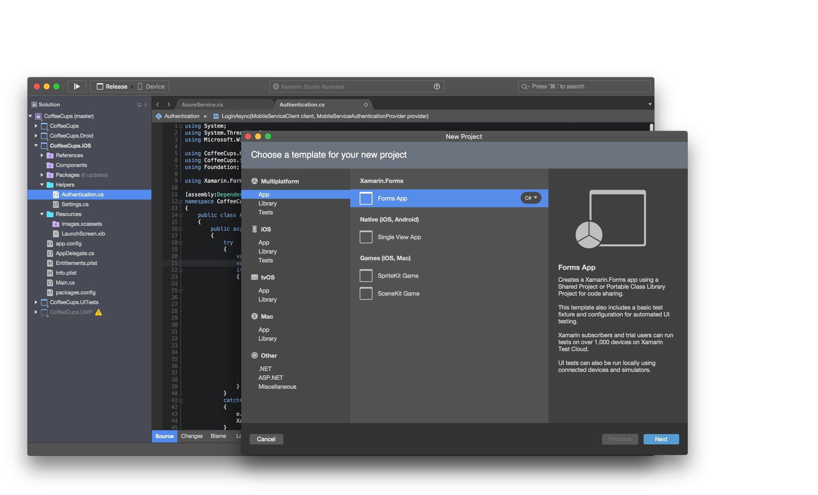
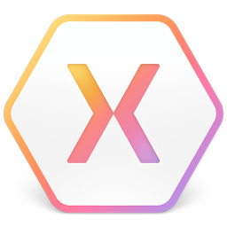
Xamarin Studio – Mac
Notes:
If you’re on a Mac, Xamarin Studio is also amazing!
Easy transitioning from Visual Studio.
Same projects work in both IDEs – so you can switch back and forth.

Slide 23
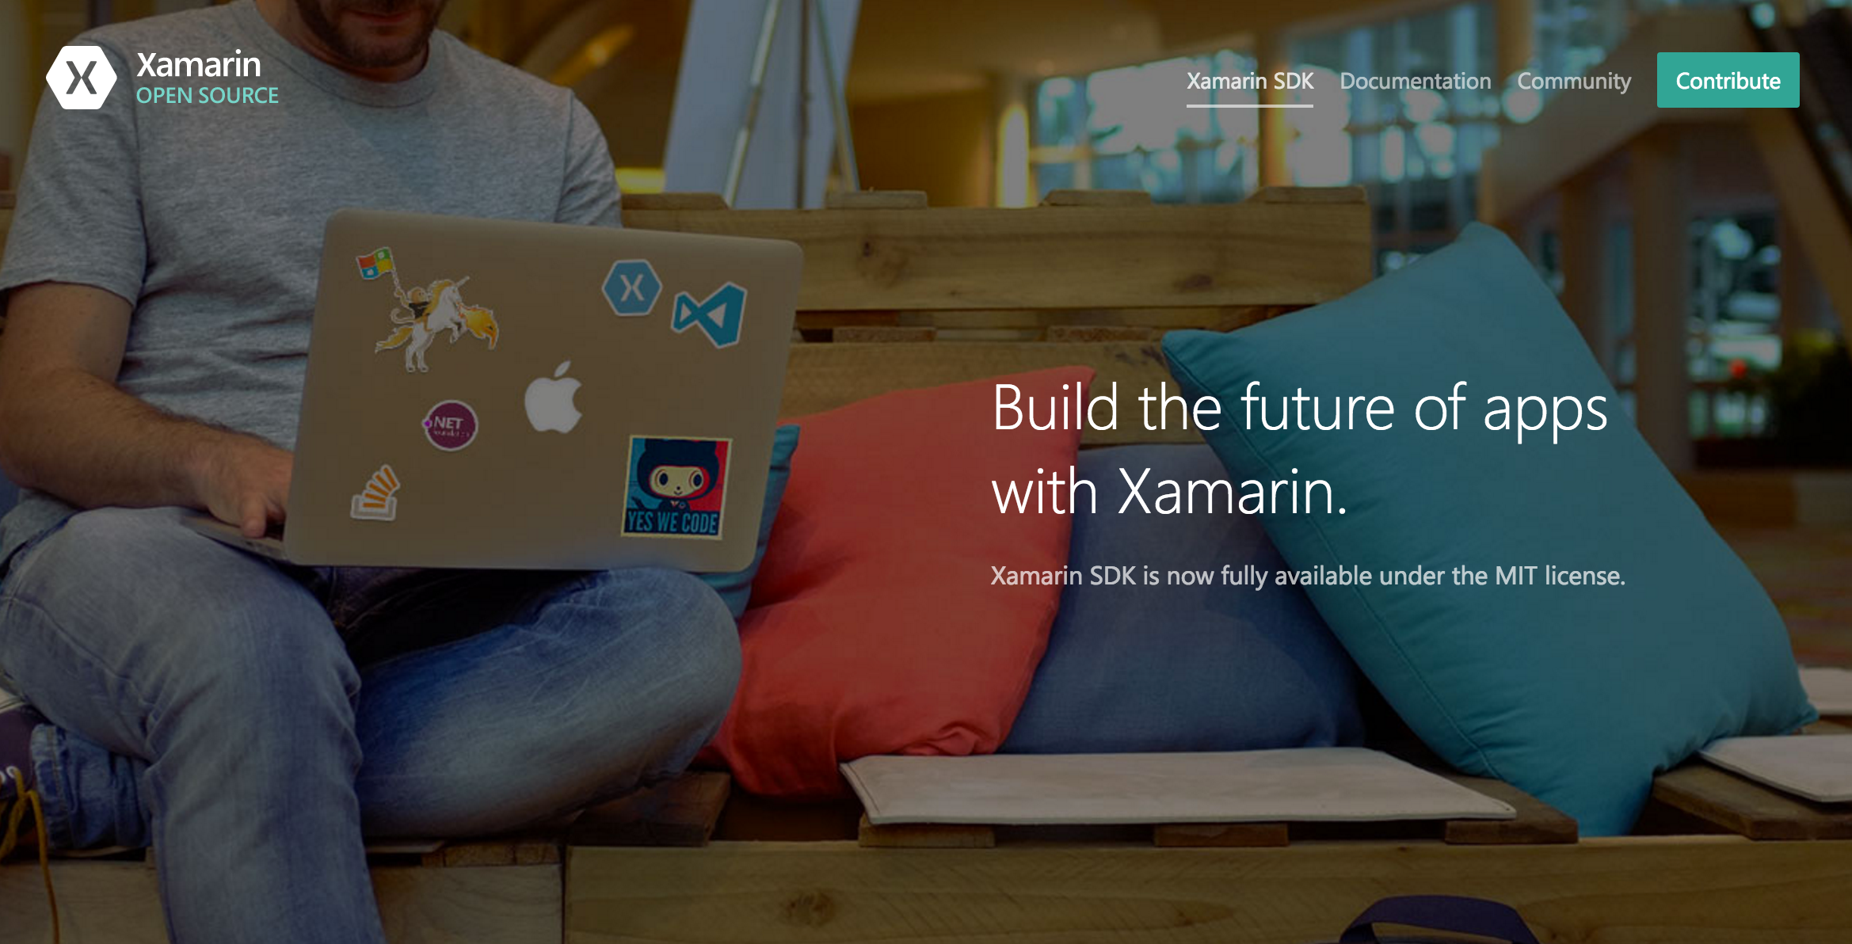
Open Source – open.xamarin.com
Notes:
Xamarin is now open source!
Check out our open source portal at open.xamarin.com
Already seeing tons of awesome contributions, from filing bugs to bringing improvements to the platform with bug fixes and enhancements

Slide 24
Sharing Code

Slide 25
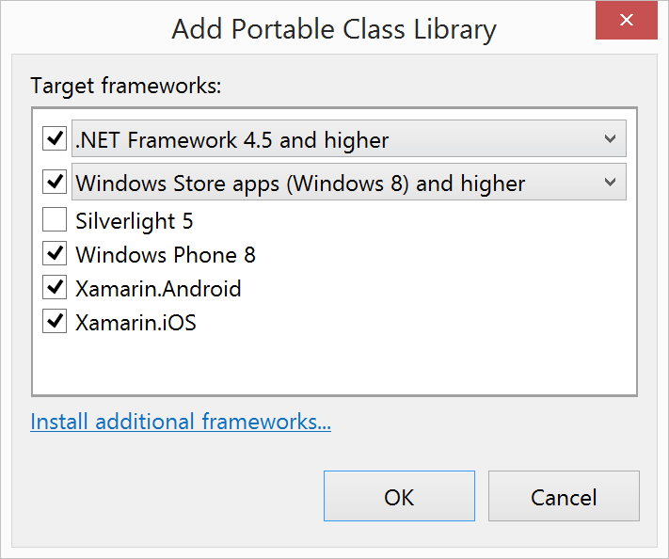
Portable Class Libraries
1 Assembly
Multiple Platforms
Including:
Xamarin.iOS and Xamarin.Android
Notes:
Portable Class Libraries are an LCD approach to sharing code.
Many different “profiles”, which essentially say what platforms are supported in the PCL.
The profile defines what APIs are supported, depending on the LCD of all the platforms in the profile.
This is great – as all code we write here is sharable across other platforms and is super portable (hence the name).

Slide 26
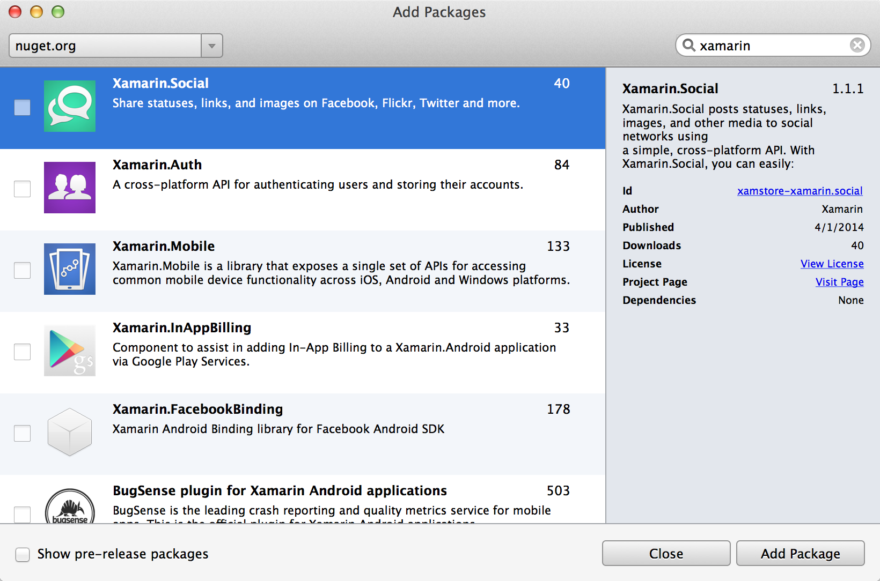
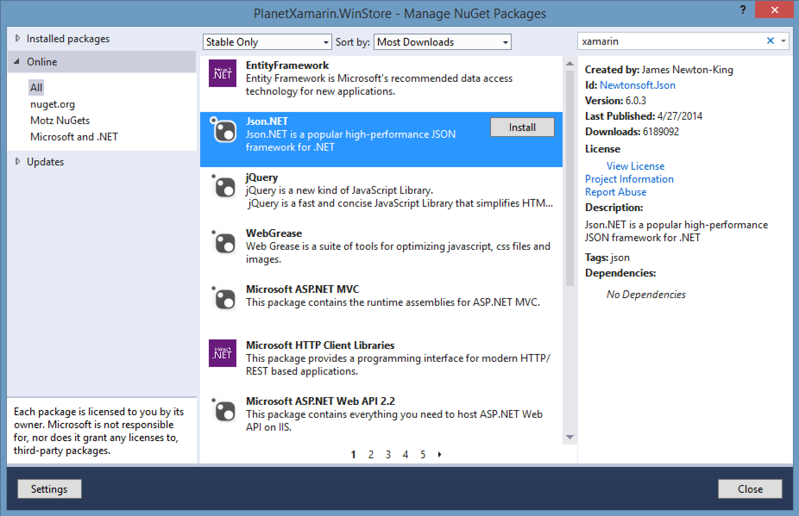
NuGet
Notes:
NuGet is a package manager for .NET.
Billions of package downloads, tons of packages available for you to consume in your Xamarin apps.
Xamarin.Forms – which we will talk about later – is distributed this way.

Slide 27
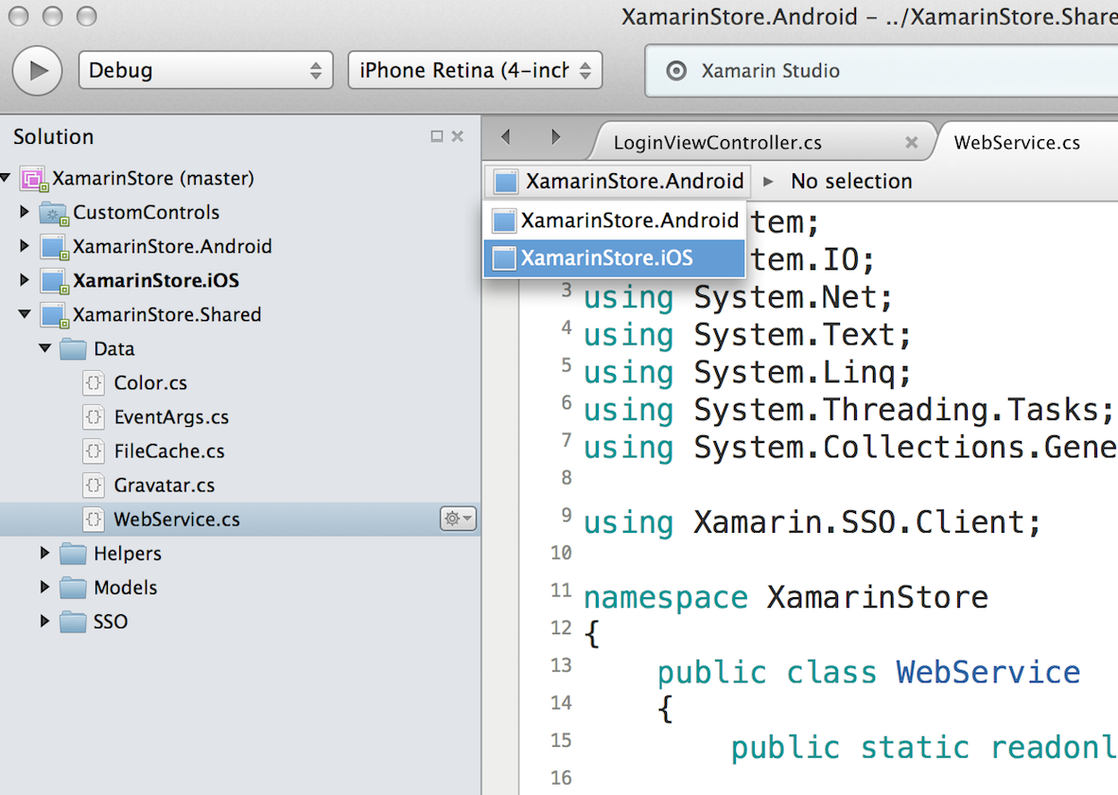
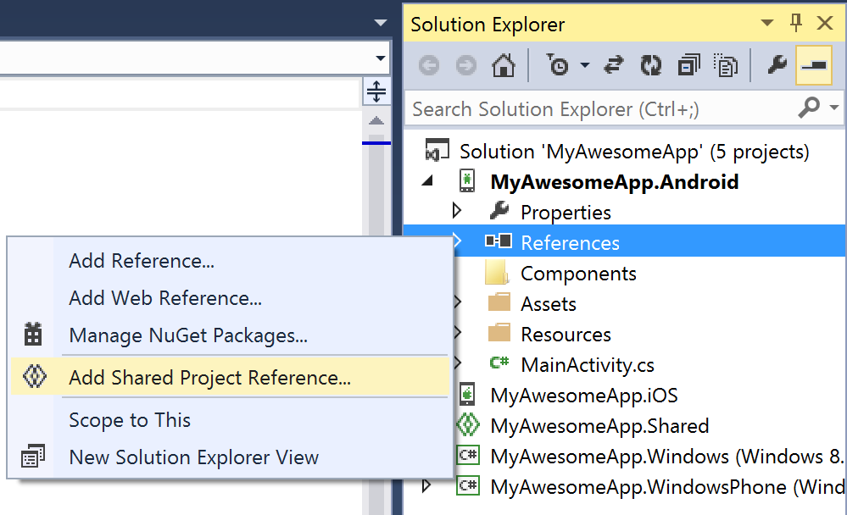
Shared Projects
Notes:
Shared Projects are similar to PCLs, but are essentially file linking.
They’re going to give you some flexibility into how you share code, but can lead to your code being less portable long term.

Slide 28
Code Sharing Stats
Calca
iCircuit
Touch Draw
Android
iOS
Mac
Windows Phone
Notes:
Few examples of code sharing in Xamarin apps here…
Calca is a calculator app that was written with Xamarin. Has super high code sharing.
iCircuit was featured in physical Apple stores and has 70%+ code sharing, which is impressive considering it’s super graphics intensive.
The same goes for Touch Draw, which is also super graphics intensive, but has lots of shared code.
Apps I’ve worked on...
MyDriving – gets around 70%+ code sharing across iOS, Android, and Windows.
Evolve App – Had 90%+ code sharing.

Slide 29
Let’s build an app!

Slide 30
Simplifying Development

Slide 31
Platform Specific Code
UI+APIs
UI + APIs
UI + APIs
Battery
GPS
Lights
Notifications
Settings
Text To Speech
Battery
GPS
Lights
Notifications
Settings
Text To Speech
Battery
GPS
Lights
Notifications
Settings
Text To Speech
What if we didn’t have to write this code?
What if we could access it from shared code?
Notes:
Lots of code is platform-specific, but is common amongst all platforms and in many apps.
What if we didn’t have to write this?
And could access it from shared code?

Slide 32
Speak(“Hello World”);
AVSpeechSynthesizer
TextToSpeech
SpeechSynthesizer
Notes:
We can create an abstraction on top of some of these APIs to call down into the native APIs for more code sharing.

Slide 33
Plugins for Xamarin
github.com/xamarin/plugins
Common API
Notes:
This is what Plugins for Xamarin does – takes platform-specific functionality and makes it cross-platform.
Tons of plugins and great open-source environment. Be sure to contribute if you find yourself writing one!

Slide 34
Let’s take a 10 minute break!

